Slide 1

Subsidiary ICT for Uganda
Curriculum Topic 7 out of 15: 7: ELECTRONIC SPREADSHEETS I
Recommended Coverage Duration: 20 periods (3 ¹/₃ weeks)
Senior Five Term II
ORDER TEXTBOOK / DOWNLOAD AT: WWW.MUKALELE.NET
Notes:
Guidance to the Teacher
Demonstrate to the learners how worksheets are managed before allowing them time to manage their own worksheets.
Give a clear explanation of the underlying principles of working with specific functions to the learners before they form functions or formulae.
For example when a label appears in a logic function, the label is put in double quotation marks.
Start with the basic formulae that can assist to make a shopping list budget before introducing the functions and order of operations in formulae. Automatic recalculation is expected.
Suggested Competences for Assessment
Assess the learners’ ability to manage the worksheet to meet user specifications/requirements, and use of formulae and functions in worksheets.

Slide 2
Background
Throughout the ages, people have always needed to calculate. Tools such as the abacus were invented by the early Chinese to help keep track of large numbers. About thirty years ago, students only had pen, paper, slide rules and mathematical tables to help them in their mathematics exams. There were no such things as calculators and certainly no personal computers. Calculators eventually became everyday tools and certainly helped to speed up calculations and improve accuracy. Even then, they weren't really good enough to solve complex problems or deal with large amounts of repetitive work. With advancement in technology, spreadsheets were developed.
A spreadsheet is a piece of software which is used to work out calculations. Spreadsheets can do a lot more than simply adding up a column of numbers. Spreadsheets can handle financial calculations for a large business, calculate probability or other statistical information, do complex trigonometry and make colorful graphs and charts. Some examples of these spreadsheets include, Microsoft Excel, VisiCalc, Lotus 1-2-3, MS-DOS spreadsheets and OpenOffice.org Calc.
Learning Outcome: The learner should be able to produce mark sheets, budgets, class planners and many others.

Slide 3
Presentation Outline
UACE Sub – ICT Topic 7:
Electronic Spreadsheets I
Sub Topic 7.1: Introduction to Spreadsheets
Sub Topic 7.2: Managing Worksheets
Sub Topic 7.3: Formulae and Functions

Slide 4
Sub Topic 7.1: Introduction to Spreadsheets
Sub topic Objectives:
7.1.1 Meaning of a spreadsheet
7.1.2 Types of spreadsheets
7.1.3 Application areas, uses of spreadsheets
7.1.4 Features of a spreadsheet
7.1.5 Working with spreadsheets
Performing Data Entry In A Worksheet.
Renaming, Inserting And Deletes Worksheets.
Saving A workbook.

Slide 5
7.1.1 Meaning of a spreadsheet
A Spreadsheet is a grid that organizes data in rows and columns.
Spreadsheet software refers to Application software packages that are used for calculations, including the creation of graphs.
Examples of spreadsheet software applications include: Microsoft Excel, Lotus 1-2-3, K-Spread, Apple Numbers, OpenOffice.org Calc, Kingsoft Spreadsheets, Quattro Pro, Ability Spreadsheet, etc.

Slide 6
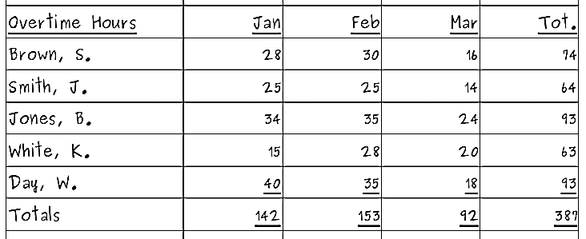
7.1.2 Types of spreadsheets
There are manual spreadsheets and electronic spreadsheets.
Manual spreadsheets are not computer based and are drawn on paper.

Slide 7
7.1.2 Types of spreadsheets
Advantages of using electronic spreadsheet over manual spreadsheets
The electronic spreadsheet utilizes the powerful aspects of the computer like speed; accuracy and efficiency to enable the user quickly accomplish tasks.
The electronic spreadsheet offers a larger visual sheet for data entry and manipulation for example the largest paper ledger you can get is on that does not exceed 30 columns and 51 rows. While with a electronic spreadsheet the least ledger has at least 255 columns and 255 rows.
The electronic spreadsheet utilizes the large storage space on computer storage devices to save and retrieve documents.

Slide 8
7.1.2 Types of spreadsheets
Advantages of using electronic spreadsheet over manual spreadsheets
The electronic spreadsheet enables the user to produce neat work because the traditional paper, pencil and rubber plus calculator are not put aside. All the work is edited on the screen and the final clear copy is printed and yet with a hand written spreadsheet, neatness depends on the writer’s hand writing.
Electronic spreadsheet has inbuilt formulas called functions that enable the user to quickly manipulate mathematical data.
Electronic spreadsheet automatically adjusts the result of the formula if the value in the worksheet is changed while for manual worksheet changing one vale means rubbing the result and writing the correct one again.

Slide 9
7.1.3 Application areas, uses of spreadsheets
Spreadsheets are used in many areas, including the following:
Budgeting and Statements. Microsoft Office Excel ships with templates for creating budgets, cash-flow statements and profit-and-loss statements, which are some of the most basic documents used in accounting.
Tabulation. Excel spreadsheets are designed to contain data in a tabular format that supports both in-line and summation calculations.
Financial Analysis. Financial analysis using spreadsheets to list customer and sales targets can help you manage your sales force and plan future marketing plans based on past results.

Slide 10
7.1.3 Application areas, uses of spreadsheets
Time Sheets. Besides adding and subtracting integers, spreadsheets can also perform those calculations on time-based numbers.
Chart Creation. Charts and graphs create better depictions of trends and percentages than raw numbers. As they say, "A picture's worth a thousand words." Spreadsheet programs can convert your data into the visuals of your choice, whether it's a pie chart, bar chart or line graph.
Lists. You can create lists, from shopping lists to contact lists, on a spreadsheet. For example, if you entered store items to a spreadsheet along with their corresponding aisles, you could sort by aisle and print before your shopping trip.
NB: Discuss more ways electronic spreadsheets are used.

Slide 11
7.1.4 Features of a spreadsheet
Below are some of the key features of electronic spreadsheets.
1. Saving. Saving enables a user to create a file for the workbook in a directory on the disk. The Save command can be accessed from the File menu. NB: The file extension of an Excel document is .xls.
2. Columns and Rows. A spreadsheet is a grid consisting of columns and rows. Rows are labelled with numbers, and columns are labelled with letters, giving each cell a unique address consisting of a number and a letter.
3. Auto Complete feature. The AutoComplete can speed up data entry, especially if you have to enter a particular word or phrase repeatedly.
When you start entering data into an empty cell, directly below an existing list, Excel will automatically offer you a match from the data above it.

Slide 12
7.1.4 Features of a spreadsheet
4. Formulas. Formulas are used to express mathematical relationships between cells. For example entering =A1+B1 in C1 would add and display the sum of cells A1 and B1 into cell C1. It could also be a simple mathematical formula, such as = (100-10 * 3) / 7. Formulas are not displayed on spreadsheets. What you see in the cell is the result of the formula. Don't forget about order of operations (BEDMAS); anything inside parenthesis happens first, followed by Exponent (^) Division (/) multiplication (*), followed by addition (+) and subtraction (-). QN: What is the result of above formula? Why?
5. Functions. Functions are used as shortcuts when performing mathematical calculations. Functions are pre-programmed formulae that give power and flexibility to spreadsheet calculations. They save the user from having to continually enter long and cumbersome formula expressions. They constitute standard keywords and syntax. Some examples are SUM, AVERAGE, MAX, and MIN.
Notes:
For example entering =A1+B1 in C1 would add and display the sum of cells A1 and B1 into cell C1. It could also be a simple mathematical formula, such as = (100-10 * 3) / 7.

Slide 13
7.1.4 Features of a spreadsheet
6. Cell References / Addresses. You can refer to a Cell by using the Column letter and Row number. For Example, D8 refers to a cell in Column D and Row 8. In this case, D8 is known as the Cell Reference and is also used as the default name for the cell.
A Circular reference occurs when a formula refers back to its own cell, either directly or indirectly. For example inserting the formula =A2+A3 in cell A2 creates a circular reference.
Notes:
Update: A Circular reference occurs when a formula refers back to its own cell, either directly or indirectly. For example inserting the formula =A2+A3 in cell A2 creates a circular reference.

Slide 14
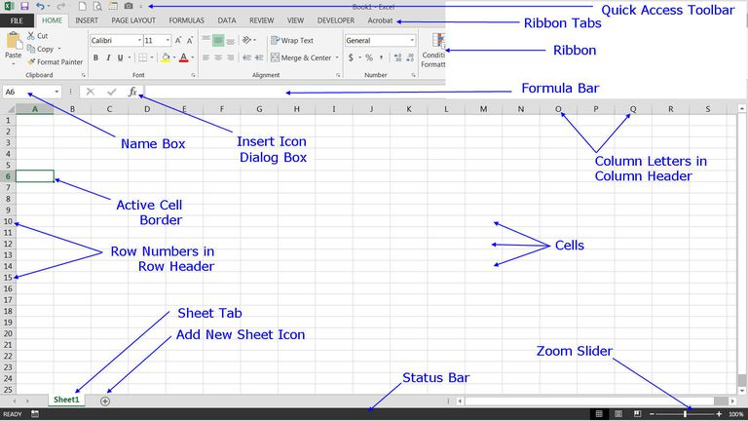
7.1.5 Working with spreadsheets
When you open a spreadsheet application such as Microsoft Excel 2013, you will see some common elements as labelled below.

Slide 15
7.1.5 Working with spreadsheets
Microsoft Excel Spreadsheet Interface Components
Active Cell - The active cell is recognized by its green outline. Data is always entered into the active cell. Different cells can be made active by clicking on them with the mouse or by using the arrow keys on the keyboard.
Add Sheet Icon - Clicking on the Add sheet icon next to the Sheet tab at the bottom of the screen adds another worksheet. (You can also use two keyboard shortcuts to add a new worksheet: Shift + F11 and Alt + Shift + F1.)
Cell - Cells are the rectangular boxes located in central area of a worksheet. Data entered into a worksheet is stored in a cell. Each cell can hold only one piece of data at a time. A cell is the intersection point of a vertical column and a horizontal row. Each cell in the worksheet can be identified by a cell reference, which is a combination of letters and numbers such as A1, F156, or AA34.

Slide 16
7.1.5 Working with spreadsheets
Microsoft Excel Spreadsheet Interface Components
Column Letters - Columns run vertically on a worksheet, and each one is identified by a letter in the column header.​
Formula Bar - Located above the worksheet, this area displays the contents of the active cell. The formula bar can also be used for entering or editing data and formulas.
Name Box - Located next to the formula bar, the Name Box displays the cell reference or the name of the active cell.
Quick Access Toolbar - The Quick Access toolbar allows you to add frequently used commands. Click on the down arrow at the end of the toolbar to display available options.
Ribbon - The Ribbon is the strip of buttons located above the worksheet. First introduced in Excel 2007, the ribbons replaced the menus and toolbars found in Excel 2003 and earlier versions.
Notes:
Microsoft Excel Spreadsheet Interface Components

Slide 17
7.1.5 Working with spreadsheets
Microsoft Excel Spreadsheet Interface Components
The File Tab: The File tab was introduced in Excel 2010, replacing the Excel 2007 Office Button, and it works differently than the other ribbons/ tabs. Instead of having its options display on the horizontal ribbon, clicking on the File tab opens a drop-down menu on the left side of the screen. This tab contains items that are mostly related to file and document management, such as opening new or existing worksheet files, saving, and printing.
Row Numbers: Rows run horizontally in a worksheet and are identified by a number in the row header.
Zoom Slider Located in the bottom right corner of the Excel screen, the Zoom slider is used to change the magnification of a worksheet when you drag the slider box back and forth or click on the Zoom Out and Zoom In buttons located at either end of the slider.

Slide 18
7.1.5 Working with spreadsheets
Microsoft Excel Spreadsheet Interface Components
Sheet Tabs: By default, there is one worksheet in an Excel 2013 file, but you can add additional sheets. The Sheet tab at the bottom of a worksheet tells you the name of the worksheet, such as Sheet1. Renaming a worksheet or changing the tab color can make it easier to keep track of data in large spreadsheet files. Switching between worksheets can be done by clicking on the tab of the sheet you want to access (or by using keyboard shortcut to change between worksheets: Ctrl + PgUp and Ctrl + PgDn).
Status Bar: The Status Bar, which runs horizontally along the bottom of screen, can be customized to display a number of options, most of which give the user information about the current worksheet, data the worksheet contains, and the user's keyboard including whether the Caps Lock, Scroll Lock, and Num Lock keys are turned on or off. The status bar also contains the Zoom slider.

Slide 19
Sub Topic 7.2: Managing Worksheets
Sub topic Objectives:
7.2.1 Inserting rows, columns and cells
7.2.2 Editing contents of a cell
7.2.3 Selecting cells
7.2.4 Copying the contents of a cell range, or worksheet between worksheets or workbooks
7.2.5 Auto fill/ copy handle tool
7.2.6 Freezing panes
7.2.7 Formatting a worksheet (adjusting column widths, row heights, applying borders and formatting cell content).

Slide 20
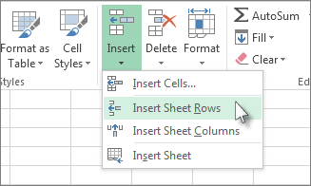
7.2.1 Inserting rows, columns and cells
You can insert blank cells above or to the left of the active cell on a worksheet. When you insert blank cells, Excel shifts other cells in the same column down or cells in the same row to the right to accommodate the new cells. Similarly, you can insert rows above a selected row and columns to the left of a selected column. You can also delete cells, rows, and columns.
Microsoft Excel has the following column and row limits: 16,384 columns wide by 1,048,576 rows tall.
NB: You can insert cells that contain data and formulas by copying or cutting the cells, right-clicking the location where you want to paste them, and then clicking Insert Copied Cells or Insert Cut Cells. Home tab, in the Cells group, There are options for inserting blank cells, rows and columns.

Slide 21
7.2.2 Editing contents of a cell
You can enter data into a cell by positioning the cursor in the cell and typing the information. The maximum number of characters that a cell can contain is 32,000.
Excel recognises text and numeric entries and initially displays them with different alignments – left for text and right for numbers. You can override these with other formats if required.
To enter information:
i. Move to the cell where you want the entry and type a word (for example NAME in cell A1).
The text will appear in the Formula bar as well as in the current cell. The cursor will be visible as a flashing insertion point in the formula bar.
ii. Click on the green tick mark on the formula bar to confirm the entry. OR Press [ENTER] to confirm the entry.
You can Edit the contents of an active cell by pressing F2 to switch to edit mode or Edit from the formula bar.

Slide 22

7.2.3 Selecting cells
To select | Do this
A single cell | Click the cell, or press the arrow keys to move to the cell.
A range of cells | Click the first cell in the range, and then drag to the last cell, or hold down SHIFT while you press the arrow keys to extend the selection. You can also select the first cell in the range, and then press F8 to extend the selection by using the arrow keys. To stop extending the selection, press F8 again.
A large range of cells | Click the first cell in the range, and then hold down SHIFT while you click the last cell in the range. You can scroll to make the last cell visible.
All cells on a worksheet | Click the Select All button. To select the entire worksheet, you can also press CTRL+A. Note If the worksheet contains data, CTRL+A selects the current region. Pressing CTRL+A a second time selects the entire worksheet.

Slide 23

7.2.3 Selecting cells
To select | Do this
Nonadjacent cells or cell ranges | Select the first cell or range of cells, and then hold down CTRL while you select the other cells or ranges. You can also select the first cell or range of cells, and then press SHIFT+F8 to add another nonadjacent cell or range to the selection. To stop adding cells or ranges to the selection, press SHIFT+F8 again. Note You cannot cancel the selection of a cell or range of cells in a nonadjacent selection without canceling the entire selection.
An entire row or column | Click the row or column heading. You can also select cells in a row or column by selecting the first cell and then pressing CTRL+SHIFT+ARROW key (RIGHT ARROW or LEFT ARROW for rows, UP ARROW or DOWN ARROW for columns). Note If the row or column contains data, CTRL+SHIFT+ARROW key selects the row or column to the last used cell. Pressing CTRL+SHIFT+ARROW key a second time selects the entire row or column.

Slide 24
7.2.3 Selecting cells
To select | Do this
Adjacent rows or columns | Drag across the row or column headings. Or select the first row or column; then hold down SHIFT while you select the last row or column.
Nonadjacent rows or columns | Click the column or row heading of the first row or column in your selection; then hold down CTRL while you click the column or row headings of other rows or columns that you want to add to the selection.
The first or last cell on a worksheet or in a Microsoft Office Excel table | Press CTRL+HOME to select the first cell on the worksheet or in an Excel list. Press CTRL+END to select the last cell on the worksheet or in an Excel list that contains data or formatting.
Cells to the last used cell on the worksheet (lower-right corner) | Select the first cell, and then press CTRL+SHIFT+END to extend the selection of cells to the last used cell on the worksheet (lower-right corner).
Cells to the beginning of the worksheet | Select the first cell, and then press CTRL+SHIFT+HOME to extend the selection of cells to the beginning of the worksheet.

Slide 25
7.2.4 Copying data between worksheets or workbooks
You can use the Cut and Copy commands to move or copy a portion of the data to other worksheets or workbooks.
In a worksheet, select the data that you want to move or copy.
If you want to move the data, press CTRL + X. If you want to copy, press CTRL + C.
Go to the worksheet where you want to paste the data, whether that sheet is in the same workbook or a different one.
Select the upper-left cell of the area in which you want to paste the data.
Note: Data in the paste area will be overwritten. Also, if the paste area contains hidden rows or columns, you might have to unhide the paste area to see all the copied cells.
Press CTRL + V. QN: How can you do this procedure with a mouse?

Slide 26
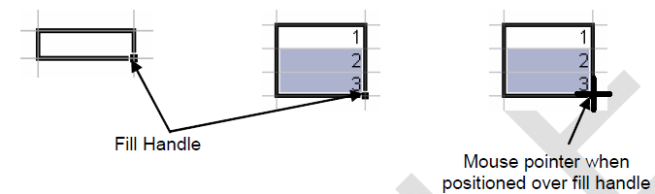
7.2.5 Auto fill/ copy handle tool
The fill handle is a very useful tool in Excel. It allows you to copy and clear data but also to fill in series of data (dates, weekdays etc.).
The fill handle appears in the bottom right hand corner of the active cell or selection. When your mouse is over the fill handle, the white plus pointer changes to a black plus.

Slide 27
7.2.5 Auto fill/ copy handle tool
Fill data into adjacent cells by using the fill handle
First, you select the cells, that you want to use as a basis for filling additional cells, and then drag the fill handle across or down the cells that you want to fill.
Fill in a series of numbers, dates, patterns, days, months etc
Select the first cell in the range that you want to fill.
Type the first values for the series. For example, if you want the series 1, 2, 3, 4, 5..., type 1 and 2 in the first two cells. If you want the series 2, 4, 6, 8..., type 2 and 4. If you want the series 2, 2, 2, 2..., you can type only in the first cell.
Select the cell or cells that contain the starting values.
Drag the fill handle across the range that you want to fill.
Notes:
(don’t start from 8) Type the first values for the series. For example, if you want the series 1, 2, 3, 4, 5..., type 1 and 2 in the first two cells. If you want the series 2, 4, 6, 8..., type 2 and 4. If you want the series 2, 2, 2, 2..., you can type only in the first cell.

Slide 28
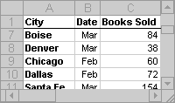
7.2.6 Freezing panes
You can view two areas of a worksheet and lock rows or columns in one area by freezing or splitting panes.
For example, you would freeze panes to keep row and column labels like “City” visible as you scroll, as shown in the screenshot.
When you split panes, you create separate worksheet areas that you can scroll within, while rows or columns in the non-scrolled area remain visible.
Selecting areas to freeze:
To lock rows, select the row below where you want the split to appear.
To lock columns, select the column to the right of where you want the split to appear.
To lock both rows and columns, click the cell below and to the right of where you want the split to appear.

Slide 29

7.2.6 Freezing panes
On the View tab, in the Window group, click Freeze Panes, and then click the option that you want.
Note: When you freeze panes, the Freeze Panes option changes to Unfreeze Panes so that you can unlock frozen rows or columns.

Slide 30
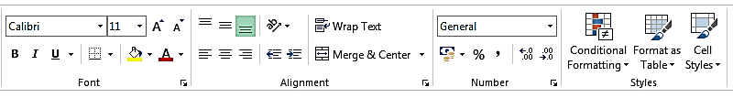
7.2.7 Formatting a worksheet
Having produced a spreadsheet, its look may be enhanced to achieve a more professional and more easily readable layout of data for both screen display and printout.
There are several different ways of formatting data in Excel to produce extremely impressive effects, and many of the tools in the FORMATTING groups (Font, Alignment, Number, and Styles) on the HOME ribbon are used for the most popular formatting tasks such as Bold, italic and underline, font style, font size, font color, fill colour, etc.
NB: Click the Font dialog box launcher for more options.

Slide 31
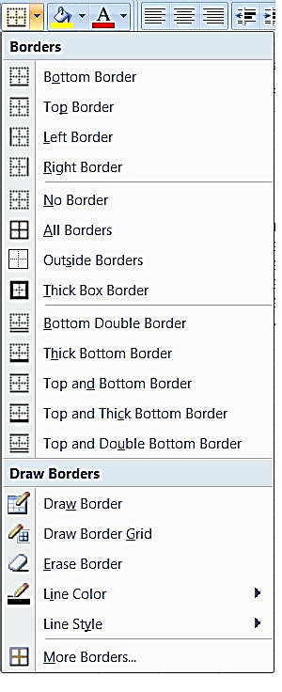
7.2.7 Formatting a worksheet
Borders: When you print a worksheet, Excel allows you to choose whether you want all the cell gridlines to be printed or not. Often, you want to print some but not all of the lines – this is when you need to apply borders.
You can then tell Excel not to print the gridlines but your borders will be printed.
To apply borders:
i. Select the area you want to border.
ii. Click the drop-down list arrow to the right of the Borders button on the Formatting toolbar.
iii. From the palette, click on the required border option.
Notes:
gridlines to be printed

Slide 32
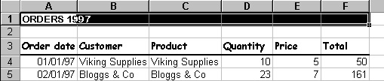
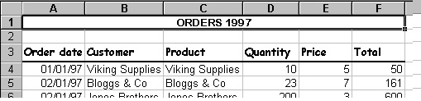
7.2.7 Formatting a worksheet
Merge Cells
If you want to type a heading across the top of a table of data, it can be quite difficult to line it up in the centre. Luckily Excel has a solution.
To merge Cells, Select the cells you want and Click the MERGE AND CENTRE button from the Formatting toolbar.
Notes:
gridlines to be printed

Slide 33

7.2.7 Formatting a worksheet
Initially, numbers in Excel use a General format. You may find that the results of formulae run to different numbers of decimal places, or you might want to display numbers as monetary values with a currency symbol and two decimal places, or express as fractions or %ages.
To Increase or decrease decimal places:
i. Select the cells with the numbers you want to change.
ii. Click the INCREASE DECIMAL button or the INCREASE DECIMAL button from the Number group on the HOME ribbon
iii. Keep clicking the button until your numbers display the correct number of decimal places.
Percent Style
Where you have typed decimals on the worksheet, you may want to express those values as percentages. You can do this with the Percent Style format. E.G. 0.5 would become 50% when you apply Percent Style.
Notes:
Number group

Slide 34
7.2.7 Formatting a worksheet
To apply Percent Style:
Select the cells with the numeric data you want to format.
Click the Percent Style button (%) from the Formatting toolbar.
To apply comma formatting
Click the comma (,) button.
To apply currency style:
Select the cells with the numeric data you want to format.
Click the Currency button from the Number group on the HOME ribbon.
Using the drop down arrow to the right of the currency button gives access to the most likely used currency formats. You can set your own currency symbols such as Shs. Or /= using custom options in the the FORMAT CELLS DIALOG box.
Notes:
To apply comma formatting
Click the comma (,) button

Slide 35
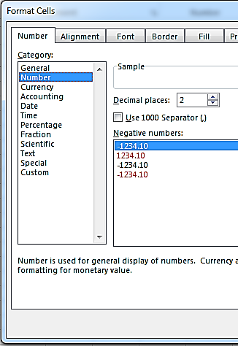
7.2.7 Formatting a worksheet
Format Cells Dialog (Ctrl+1)
This dialog contains all the formatting options (including those accessible via the Formatting toolbar) that you can use within the Excel application.
The Format Cells dialog is divided into tabs, each tab dealing with a format category.
To access this dialog, Click the DIALOG BOX LAUNCHER. From either the FONT, ALIGNMENT or NUMBER group on the HOME ribbon OR i. Press [CTRL]+[1]
Notes:
Ctrl+1

Slide 36
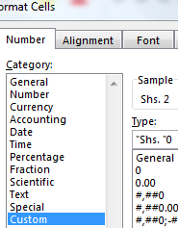
7.2.7 Formatting a worksheet
Using the Format Cells dialog to apply custom number formats
You can set custom number formats such as applying the Shs. Symbol before the values by typing a custom number format code under the “Type:” text box on the Number Tab of the Format cells dialog box.
For example, the code “Shs. ”0 appends the Shs. Symbol before the value in a cell as shown. The 0 acts as a placeholder to the values.
NB: Other code examples are shown in the dialog box and are documented in the Access help manuals. For details, Open Ms Access 2007, type (F1) and search for ‘Format Property - Number and Currency Data Types.’
Notes:
NB: Other code examples are shown in the dialog box and are documented in the Access help manuals. For details, Open Ms Access 2007, type (F1) and search for ‘Format Property - Number and Currency Data Types.’

Slide 37
7.2.7 Formatting a worksheet
Using the Format Cells dialog to apply change cell data orientation
To change orientation:
1. Select the cells you want to format.
ii. Open the Format cells dialog box and Click the ALIGNMENT tab.
iii. In the ORIENTATION section, to keep characters horizontal but arrange them one underneath the other, click the picture that corresponds.
iv. Drag the red dot marker up or down to give a degree value of plus or minus 90° from the base position (horizontal).
v. Click OK to apply the new formats and close the dialog.
Notes:
NB: Other code examples are shown in the dialog box and are documented in the Access help manuals. For details, Open Ms Access 2007, type (F1) and search for ‘Format Property - Number and Currency Data Types.’

Slide 38
Sub Topic 7.3: Formulae and Functions
Sub topic Objectives:
Types of operators
Types of cell referencing
Formulae
Functions (sum, average, max, min, lookup, count, mode, median, frequency and var)
Error alerts

Slide 39
7.3.1 Types of operators
The Excel Operators perform actions on numeric values, text or cell references.
There are four different types of Excel Operators.
These are:
Arithmetic Operators
Text Operator
Comparison Operators
Reference Operators
Arithmetic Operators
Operator | Description | Precedence (1=top; 3=bottom)
% | The percent operator | 1
^ | The exponentiation operator | 1
* | The multiplication operator | 2
/ | The division operator | 2
+ | The addition operator | 3
- | The subtraction operator | 3

Slide 40
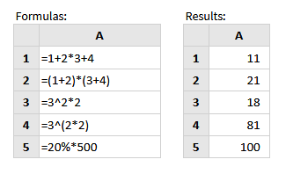
7.3.1 Types of operators
Precedence: when evaluating Excel Formulas that contain more than one arithmetic operator, the percent and exponentiation operators are evaluated first, followed by multiplication and division operators. Finally, the addition and subtraction operators are evaluated.
Arithmetic Operator Examples

Slide 41

7.3.1 Types of operators
Text Operator
The Excel Concatenation Operator (denoted by the & symbol) joins together text strings, to make a further, single text string.
The following formula uses the concatenation operator to combine the text strings "SMITH", ", " and "John"

Slide 42
7.3.1 Types of operators
Operator | Description
= | Equal to
> | Greater than
< | Less than
>= | Greater than or equal to
<= | Less than or equal to
<> | Not equal to
Comparison Operator
The Excel Comparison Operators are used when defining conditions (for example when using the Excel If Function). These operators are listed in the table below:

Slide 43
7.3.1 Types of operators
Excel Reference Operators
used when referring to ranges within a spreadsheet:
Operator | Description
: | Range operator (defines a reference to a range of cells) eg A1:A11
, | Union operator (combines two references into a single reference) eg A1,A3
(space) | Intersection operator (returns a reference to the intersection of two ranges)

Slide 44
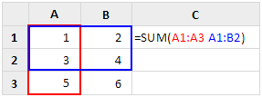
7.3.1 Types of operators
Excel Reference Intersection Operator Example
Cell C1 of the following spreadsheet shows the intersection operator, used to define a range made up of cells in the intersection of ranges A1-A3 and A1-B2.
The resulting range (range A1-A2) is then provided to the Excel Sum Function, which adds together the values in the intersecting range and returns the value 4.

Slide 45
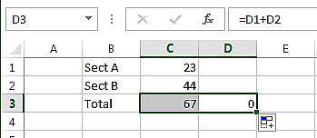
7.3.2 Types of cell referencing
RELATIVE, ABSOLUTE AND MIXED CELL REFERENCES
Relative Reference: A relative reference is a cell address that changes when it is copied to other cells in a spreadsheet. This is because it is based on the relative position of the cell.
Example: If in the cell C3 we have the formula =C1+C2, and we copy the formula to cell D3, then it would automatically adjust to = D1+D2.

Slide 46
7.3.2 Types of cell referencing
RELATIVE, ABSOLUTE AND MIXED CELL REFERENCES
Absolute Reference: An absolute cell reference is a cell address that does not change when it is copied to other cells in the spreadsheet. Absolute references always refer to cells in a specific location.
To make a cell address absolute, we insert the dollar symbol $ before the letter that identifies the column and before the number that identifies the row, example B1 becomes $B$1.
If you copy the formula across rows or down columns, the absolute reference does not adjust.

Slide 47
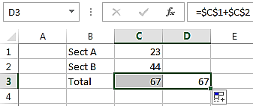
7.3.2 Types of cell referencing
RELATIVE, ABSOLUTE AND MIXED CELL REFERENCES
Absolute Reference Example: If in the cell C3 we have the formula =$C$1+$C$2, and we copy the formula to cell D3, then it would remain the same =$C$1+$C$2.

Slide 48
7.3.2 Types of cell referencing
RELATIVE, ABSOLUTE AND MIXED CELL REFERENCES
Mixed Reference: is when you have either: an absolute column and a relative row e.g. $C1 or a relative column and an absolute row e.g. C$1. And if the cell address is copied to other cells, the relative part changes and the absolute part does not change.
Note: An easy way to add the dollar signs to a cell reference is to press the F4 key on the keyboard when editing a cell reference.

Slide 49
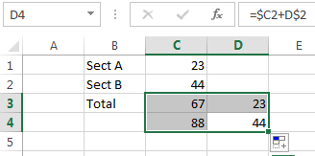
7.3.2 Types of cell referencing
RELATIVE, ABSOLUTE AND MIXED CELL REFERENCES
Mixed Reference Example: If in the cell C3 we have the formula =$C1+C$2, and we copy the formula to cell D4, then it would automatically adjust to =$C2+D$2.
Notes:
=$C1+C$2, and we copy the formula to cell D4, then it would automatically adjust to =$C2+D$2

Slide 50
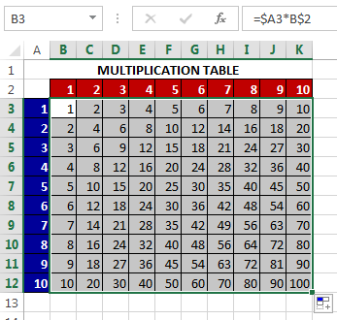
7.3.2 Types of cell referencing
Mixed Cell Reference Application Example:
You can enter one formular using mixed cell references: =$A3*B$2 in cell B3 and then copy it to the rest of the cells in the range B3:K12 to automatically generate the products in the multiplication table on the right. Column A and Row 2 are made absolute because for all the multiplications, a cell from Col A and Row 2 are involved.
Notes:
=$C1+C$2, and we copy the formula to cell D4, then it would automatically adjust to =$C2+D$2

Slide 51
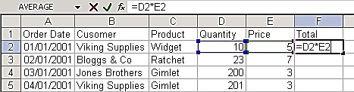
7.3.3 Formulae
You enter formulae by typing them in the cell where you want the formula’s result to appear. When you confirm entry of a formula, Excel will display the result on the worksheet, but the underlying calculation appears on the Formula bar.
To enter a formular
i. Move to the cell where you want to enter the formula.
ii. Type an equals sign (=).
iii. Type the formula (e.g. D2*E2).
iv. Press [ENTER] to confirm the entry.
NB: The result automatically recalculates if any determinant values change. It is this automatic recalculation which makes spreadsheets invaluable.
Notes:
=$C1+C$2, and we copy the formula to cell D4, then it would automatically adjust to =$C2+D$2

Slide 52
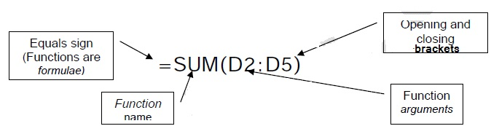
7.3.4 Functions
You could construct a formula to generate a total at the bottom of a column (or the end of a row), like this: =D2+D3+D4+D5
The above formula would work, but if there were 400 cells to total and not just 4, you would get bored with entering the individual cell references.
When formulae become unwieldy or complex, Excel comes to the rescue with its own predefined, named, built-in formulae known as functions. Functions follow the same syntax:
Notes:
=$C1+C$2, and we copy the formula to cell D4, then it would automatically adjust to =$C2+D$2

Slide 53
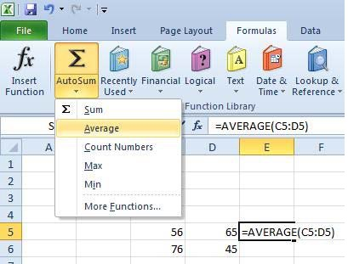

7.3.4 Functions
Excel has a huge number of functions. The functions are categorized according to what they do. Function categories include Financial, Logical, Lookup, Text, Date and Time.
Excel displays information about function arguments as you build a new formula. The tool tips also provide a quick path to HELP. Detailed documentation and examples on all functions can also be accessed through the HELP facility by pressing F1.
Notes:
=$C1+C$2, and we copy the formula to cell D4, then it would automatically adjust to =$C2+D$2

Slide 54

7.3.4 Functions
Common Functions
SYNTAX | FUNCTION DESCRIPTION
=AVERAGE(C1:C4) | Find the average (mean) of a list of numbers.
=COUNT(B4:B12) | Counts the number of cells which have a number in them
=MAX(A2:A6) | Largest of the numbers in the range A2:A6
=MEDIAN(A2:A6) | Median of all the numbers in the range A2:A6
=MIN(A2:A6) | Smallest of the numbers in the range A2:A6
=MODE(A2:A6) | Returns the commonest or most frequently occurring number in the range A2:A6
=SUM(C1:C4) | Adds a all of numbers in the range C1:C4
Notes:
=$C1+C$2, and we copy the formula to cell D4, then it would automatically adjust to =$C2+D$2

Slide 55

7.3.4 Functions
Common Functions
FUNCTION SYNTAX | FUNCTION DESCRIPTION
=LOOKUP (4.19, A2:A6, B2:B6) | Looks up 4.19 in column A, and returns the value from column B that is in the same row.
=FREQUENCY (A2:A10, B2:B4) | Calculates how often values occur within a range of values, and then returns a vertical array of numbers. For example, use FREQUENCY to count the number of test scores that fall within ranges of scores.
=VAR(A2:A11) | Estimates the variance of a sample of values in the range A2:A11. VAR uses the following formula: where x is the sample mean AVERAGE(A2:A11) and n is the sample size.
Notes:
=$C1+C$2, and we copy the formula to cell D4, then it would automatically adjust to =$C2+D$2

Slide 56
7.3.5 Error alerts
The table below provides a quick reference guide of what each of the different error messages means.
ERROR | Description
#NULL! | Arises when you refer to an intersection of two ranges that do not intersect, Or is a space was used instead of a comma in a formula.
#DIV/0! | Occurs when a formula attempts to divide by zero.
#VALUE! | Occurs if one of the variables in your formula is of the wrong type (e.g. text value when a numeric value is expected).
#REF! | Arises when a formula contains an invalid cell reference.
#NAME? | Occurs if Excel does not recognise a formula name or does not recognise text within a formula.
#NUM! | Occurs when Excel encounters an invalid number.
#N/A | Indicates that a value is not available to a formula.
Notes:
Further details and examples of each error type are provided further down the page.

Slide 57
Subsidiary ICT for Uganda
End of Topic 7:
Electronic Spreadsheets I
Next Topic 8: Internet and World Wide Web

